Slide 1
NorthWind company
Presented by Ice Asortse

Slide 2
overview
Welcome to Northwind Company , My name is Ice Asortse and I’m am data scientist.
Today I’d like to share with you about the hypothesis testing and statistical analysis in Northwind Company .
First, I’m going to share with you about our hypothesis testing, then the statistical analysis and finally our recommendations.
If you have any questions, please don’t hesitate to interrupt me. I’m happy to answer any questions as we move along.

Slide 3
Data collection
We collected data from certain department of the company and performed a hypothesis testing about key questions that could improve the baseline of the company.
Factors considered
Region of orders
Quantity of orders
Sales Revenue
Unit Price of orders

Slide 4
Questions to be answered
Does discount amount have a statistically significant effect on the quantity of a product in an order? If so, at what level(s) of discount?
Does discount have statistically significance on sales revenue? If so, at what level(s) of discount?
Is there a statistical difference in the mean sales revenue in North America vs the rest of the countries?
Is there a statistical difference in the mean quantity of products ordered by customers from North America vs the rest of the world?

Slide 5
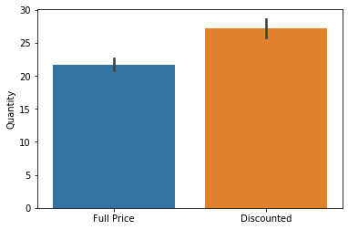
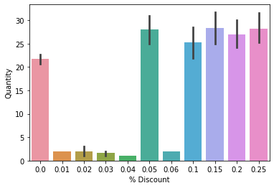
Discount and Quantity of orders hypothesis
Does discount amount have a statistically significant effect on the quantity of a product in an order? If so, at what level(s) of discount?
Discount has statistically significant effect on the quantity of product in an order.

Slide 6
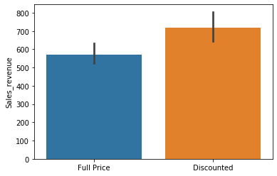
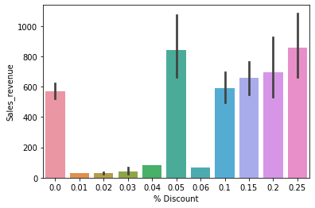
Discount and sales revenue
Does discount have statistically significance on sales revenue? If so, at what level(s) of discount?
Discount also has a statistically significant effect on the sales revenue.

Slide 7
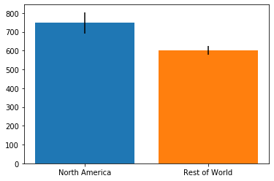
Mean sales vs rest of the world
Is there a statistical difference in the mean sales revenue in North America vs the rest of the countries?
There is a statistically significant difference in the average sales revenue in North America compared to the rest of the world.

Slide 8
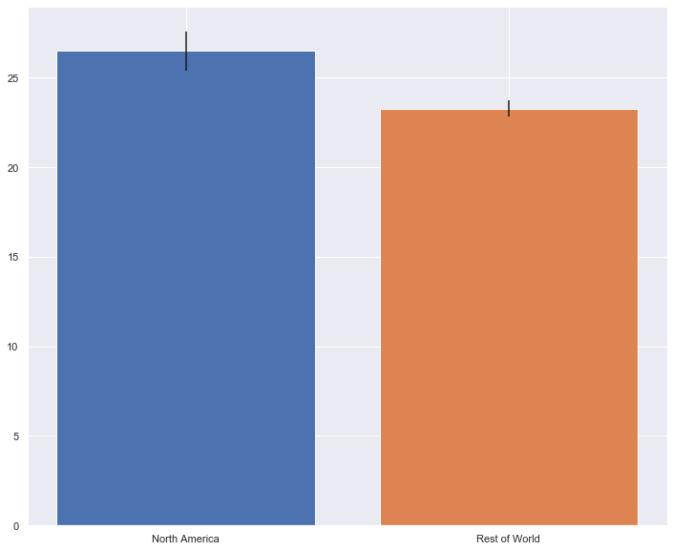
Mean quantity order in America vs world
Is there a statistical difference in the mean quantity of products ordered by customers from North America vs the rest of the world?
There is a statistically significant difference in the average quantity of products ordered by customers from North America compared to the rest of the world.

Slide 9
Recommendation
Since discount have a statistically significant effect on the quantity of products ordered, we recommend that discount of 5%, 15%, 20% and 25% should be given.
Discount also has a statistically significant effect on sales revenue so we recommend the discount of 5% and 25% however, 5% has same effect as 25% so 5% is recommended.
Since there is a statistically significant difference in the mean sales revenue we recommend that we should focus on North American market.
There is a statistical difference in the mean quantity of products ordered by customers in North America as compared to the world so we recommend that we should improve our effort towards doing more business in North America.

Slide 10
Future directions
If time permits we would like to look at other regions that have a potential to increase our sales revenue and quantity of products ordered.

Slide 11
Thank you
Any questions?

